Slide 1
THE PSYCHOLOGY OF USABLE THINGS
Human Computer Interaction
Hoan Ng

Slide 2
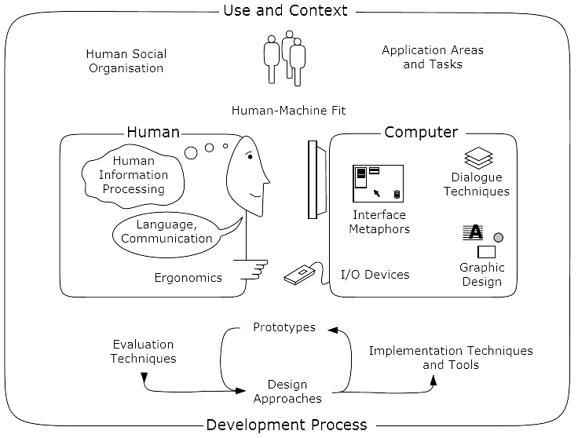
Content
The nature of Human-Computer Interaction. Adapted from the ACM SIGCHI
Curricula for Human-Computer Interaction [Hewett et al., 2002]

Slide 3
Agenda
Psychopathology of Everyday Things
Psychology of Everyday Things
Psychopathology of Computers
Notes:
Psychopathology : (y học) bệnh học tâm lý, bệnh học tinh thần
Psychology : tâm lý học

Slide 4

The Psychopathology of Everyday Things

Slide 5
Examples of where the design of everyday things went wrong.
Can you use all the functions of your: • digital watch? • mobile phone? • washing machine? • video recorder?

Slide 6
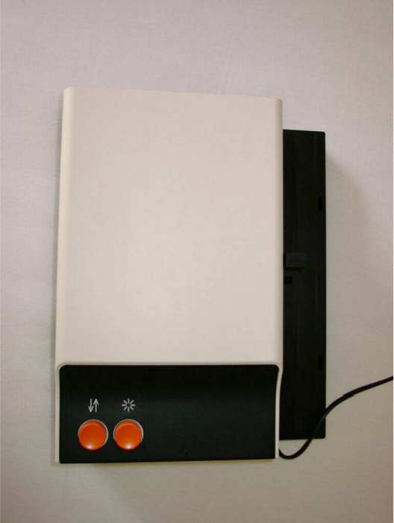
Slide controller
The Zeiss Ikon Perkeo 511 slide projector. A short press advances to the next slide, a long press moves back one slide, but how should first-time users know this?
Notes:
• Only one button to control the slide advance
During lectures, sometimes the slides go forwards, sometimes they go backwards . . . • If you can find an instruction manual: Short press = forward, long press = backward. • What an elegant design, two functions with just one button! • But how should first-time users know what to do?

Slide 7
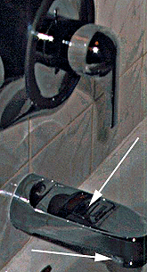
Shower Control
Shower control: water either goes into the bath out of the faucet or comes out of the shower
Sticker with instructions on the faucet.
How do you make the water come out of the shower instead of the faucet?
You have to reach under the faucet and pull the knob down!
http://baddesigns.coml
Notes:
Hidden controls
How do you turn on the shower? (Example 1)
This has got to be the worst design ever for a shower control. It is so bad there is a sticker on the faucet giving instructions for how to make the water come out of the shower instead of the faucet. You'll never guess how you turn on the shower. You reach under the faucet, grab the part where the water comes out and pull down on it!
Design suggestion
This design is bad for a number of reasons. One is that nothing else works like this. Another is that the "control" for turning on the shower doesn't look anything like a control, so the control is basically hidden. Frequently, when devices come with instructions stuck on them, there is a problem with the design.

Slide 8
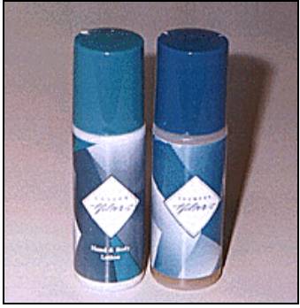
What's in the bottle?
http://baddesigns.com/shampoo.html
Notes:
Different things that are too similar!!!
What's in the bottle? (Example 1)
A lot of manufacturers package both shampoo and conditioner in nearly identical bottles. You ought to be able to easily distinguish between them in the shower without your glasses on. Going on a trip, I quickly packed my suitcase taking the hand lotion (bottle on the left) instead of the shampoo (bottle on the right). I didn't discover my mistake until I was in the shower the next morning in the motel and my hair was full of hand lotion! Have you ever tried to wash hand lotion out of your hair with a bar of soap? For a similar bad design example see: What's in the bottle? (Example 2).
Design suggestion
Things that need to be distinguished from each other should differ by more than just a single feature. For example, the bottles could have different shapes and sizes to make them more distinguishable.

Slide 9
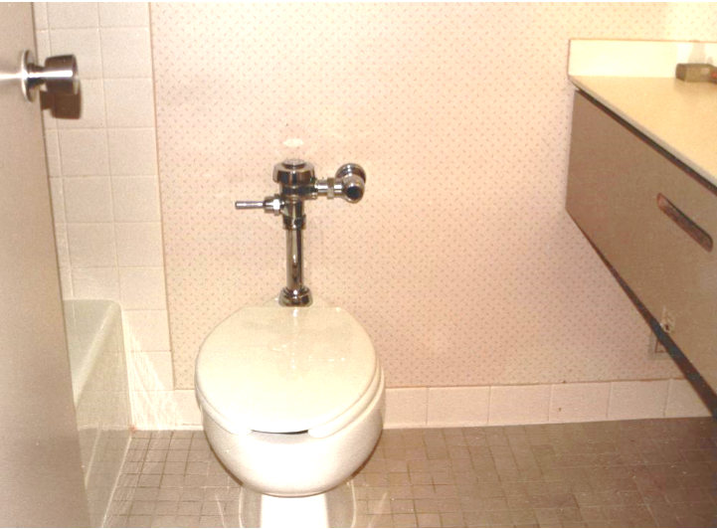
Where is the Toilet Paper?
Can you see where the toilet paper is in this hotel bathroom?

Slide 10
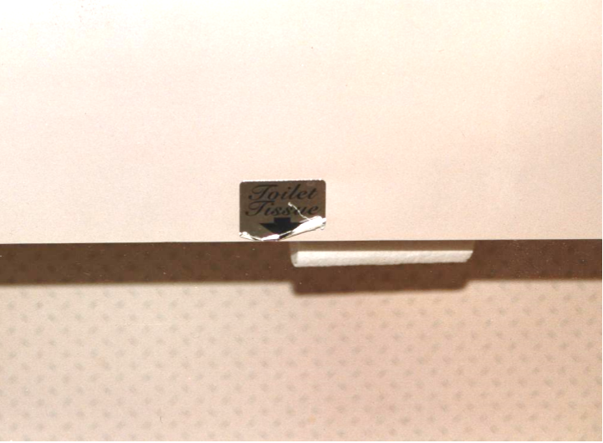
Ah, there it is! Well-hidden

Slide 11
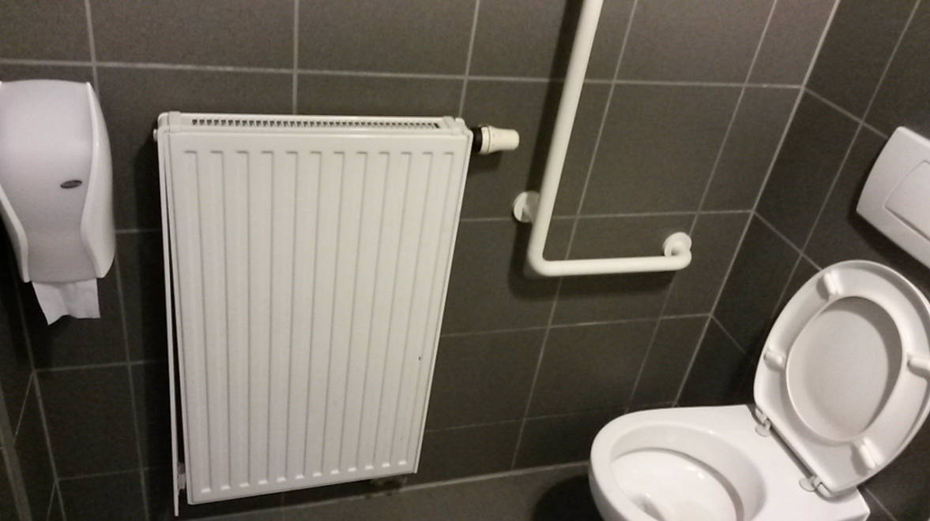
Bad design?
Notes:
The toilet paper here is easy to see, but a little too far away

Slide 12
Conclusion
Things that are hard to use because they do not follow human factors principles

Slide 13
Bad Design
“ When simple things need pictures, labels, or instructions, the design has failed. ”
“Poorly designed objects are not that easy to understand. They doesn't contain visible clues to their operation.”
[ Don Norman, The Design of Everday Things, 1988 [Norman, 1992, page 9] ]

Slide 14
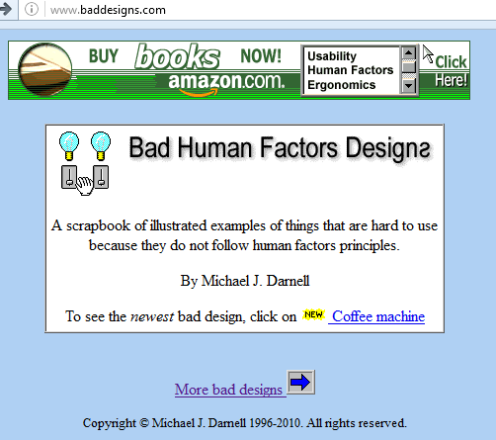
BadDesign.com

Slide 15
The Psychology of Everyday Things
Perceived and Real Affordances
Real World Affordances
GUI Affordances
Labels
Mappings
Constraints
Conventions
The Principle of Causality
Notes:
• tâm lý
• tâm lý học
• khái luận về tâm lý; hệ tâm lý

Slide 16
Perceived and Real Affordances
Aﬀordances are the range of possible (physical) actions by a user on an artefact:
Perceived Aﬀordances are the actions a user perceives to be possible.
Real Aﬀordances are the actions which are actually possible.
Perceived affordances are what we think it can do, which may be correct or incorrect
The way to make sure the affordances are clear (that is, the perceived affordances match the real affordances) is to use signifiers, which are signs indicating what you can do
Notes:
Affordances là phạm vi có thể hành động (vật lý) bởi một người dùng trên một vật phẩm: Affordances nhận thức là những hành động của một người sử dụng cảm nhận được có thể. Affordances thực là những hành động đó là thực sự có thể.
When you first see something you have never seen before, how do you know what to do? The answer, I decided, was that the required information was in the world: the appearance of the device could provide the critical clues required for its proper operation
The designer cares more about what actions the user perceives to be possible than what is true. (emphasis added)
This is what the interface designer should care about: Does the user perceive that clicking on that object is a meaningful, useful action, with a known outcome? (emphasis added)
The presence of an affordance is jointly determined by the qualities of the object and the abilities of the agent that is interacting.

Slide 17
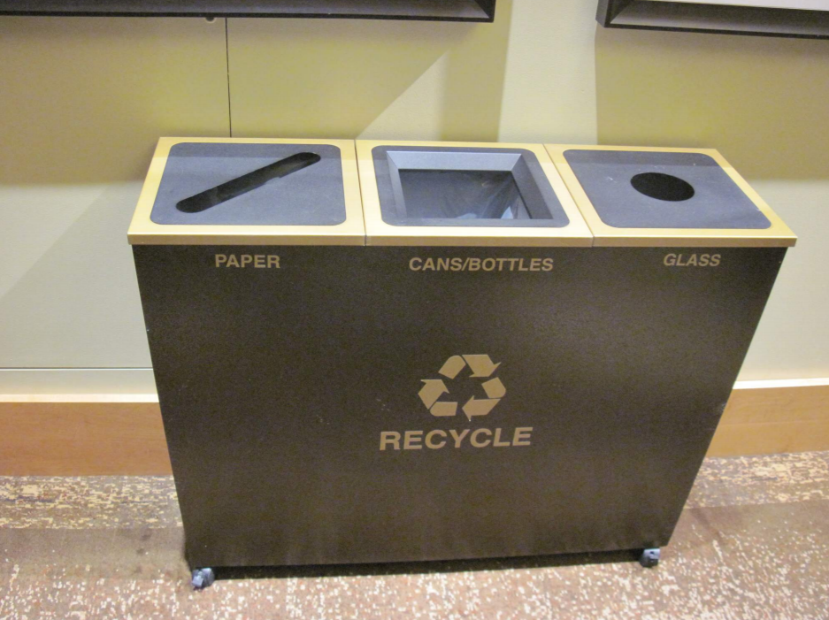
good affordances of rubbish bins. The shape of the slot affords the type of rubbish which should be inserted

Slide 18
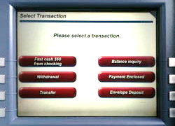
Perceived and Real Affordances

Slide 19
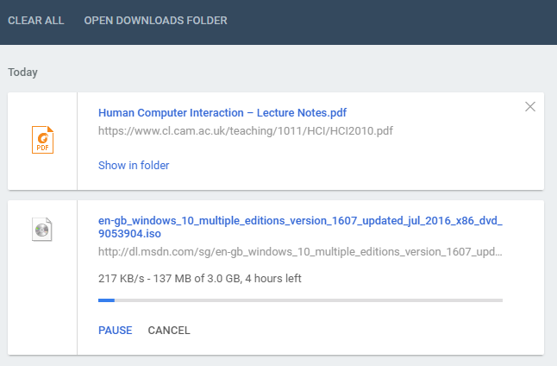
Perceived and Real Affordances

Slide 20
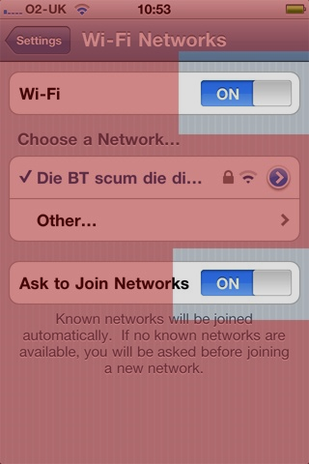
Less Helpful Affordance
The on/off slider button on the iPhone was changed when iOS4 was launched and the new design continues to confuse.

Slide 21
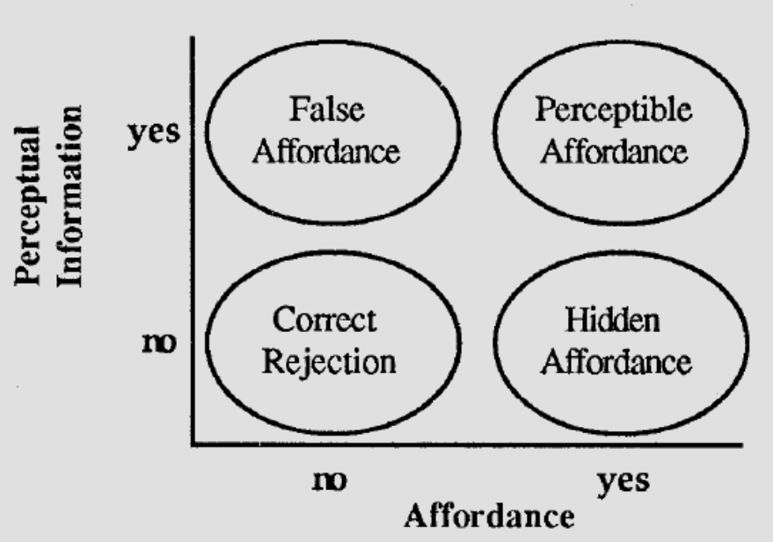
Perceived Aﬀordances

Slide 22
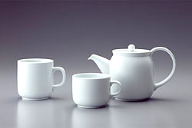
Affordance Example
The handles on a tea set provide an obvious affordance for holding.

Slide 23
Strong Affordances
A lot of basic engineering elements have strong affordances.
For example:
when you see a button, you want to push it.
when you see a switch, you want to flip it.
when you see a crank, you want to turn it (although usually you can't tell if it affords being turned clockwise or counter-clockwise)

Slide 24
Real World Affordances
For physical objects,there can be both real and perceived aﬀordances(and the two sets are not necessarily the same).
Appearance indicates how to use something:
A chair aﬀords (suggests) sitting.
Knobs are for turning.
Slots are for inserting things.
A button aﬀords pushing.
When perceived aﬀordances are taken advantage of, the user knows what to do just by looking.

Slide 25
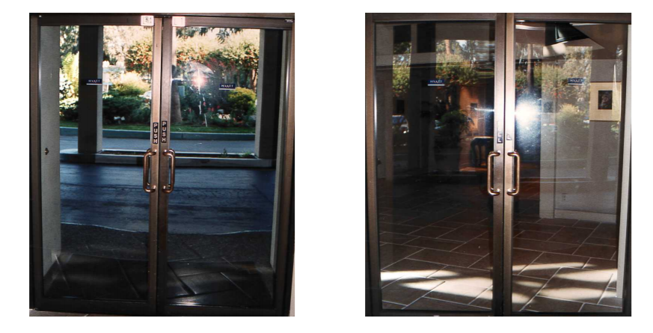
Norman Doors
Badly designed doors are sometimes called “Norman doors”
A door where the design tells you to do the opposite of what you’re actually supposed to do.”
Notes:
: An example of ambiguous affordances in door design. The vertical handles mounted on both sides of the door suggest grasping and pulling. Unfortunately, from one side, the door has to be pushed! Note the signs above the handles.

Slide 26
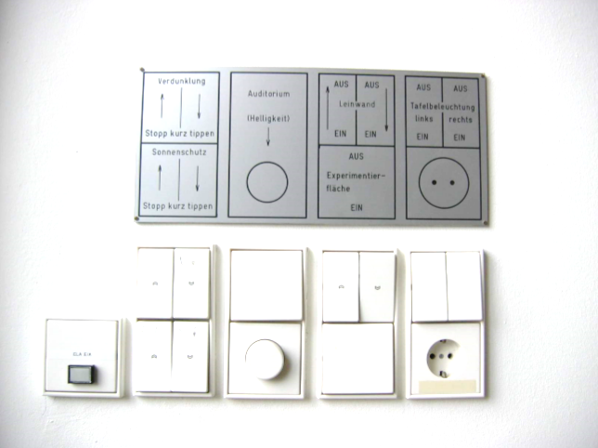
Labels
“When simple things need pictures, labels, or instructions, the design has failed!” Norman [1992, page 9]
Notes:
Affordances determine what actions are possible. Signifiers communicate where the action should take place.

Slide 27
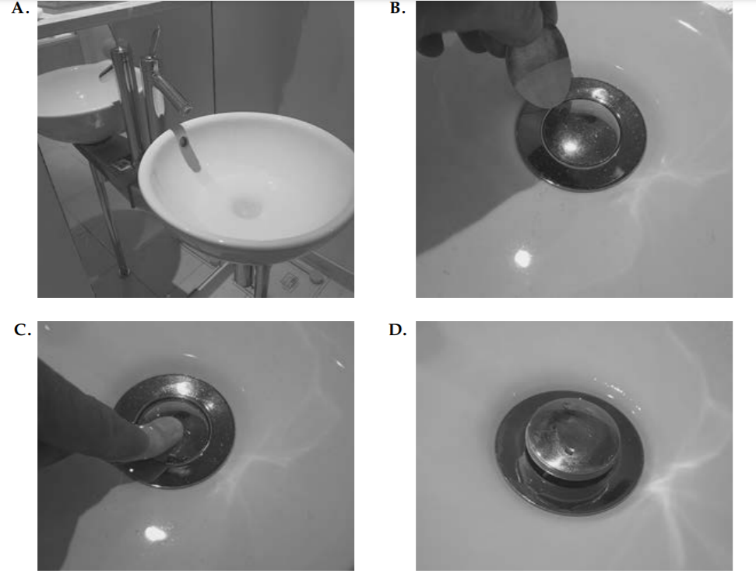
How to empty the sink?
Notes:
. I washed my hands in my hotel sink in London, but then, as shown in Photo A, was left with the question of how to empty the sink of the dirty water. I searched all over for a control: none. I tried prying open the sink stopper with a spoon (Photo B): failure. I finally left my hotel room and went to the front desk to ask for instructions. (Yes, I actually did.) “Push down on the stopper,” I was told. Yes, it worked (Photos C and D). But how was anyone to ever discover this? And why should I have to put my clean hands back into the dirty water to empty the sink? The problem here is not just the lack of signifier, it is the faulty decision to produce a stopper that requires people to dirty their clean hands to use it.

Slide 28
GUI Affordances
For screen-based interfaces, the computer hardware already has built-in physical aﬀordances:
Screen aﬀords touching.
Mouse aﬀords pointing.
Mouse buttons aﬀord clicking.
Keyboard aﬀords typing.
Changing the shape of the cursor to indicate a clickable link is not an aﬀordance (you can still click anywhere), but visual feedback.
Physically locking the mouse button on non-clickable areas is a real aﬀordance.

Slide 29
Mappings
Mappings are the relationships between controls and their eﬀects on a system. Natural mappings take advantage of physical analogies and cultural standards.
Examples:
Turn steering wheel clockwise to turn a car right. Actually, there are two mappings here:
which control aﬀects steering,
which direction to turn it.
Move a control up to move an object up.
Use a louder sound to mean a greater amount.

Slide 30
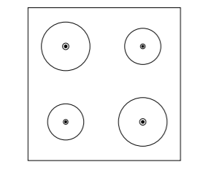
Mapping
How should one arrange the hot plate controls on a cooker?

Slide 31
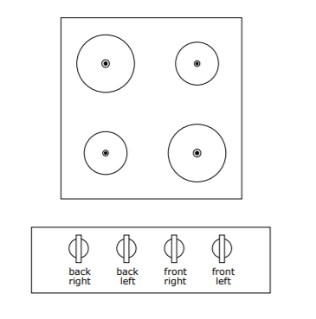
Arbitrary mapping of controls to hot plates. There are 24 possible arrangements, requiring the use of labels and memory.

Slide 32
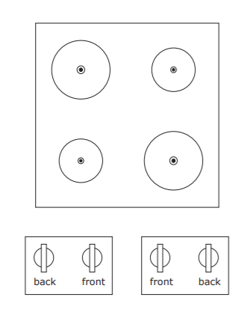
Paired cooker controls. Now there are only four possible arrangements, two on each side, but confusion can still occur.

Slide 33
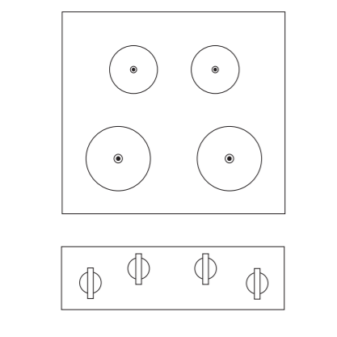
A full, natural mapping of cooker controls. There is no ambiguity, no need for learning or remembering, and no need for labels.

Slide 34
Feedback
Feedback—communicating the results of an action.
Feedback must be immediate: even a delay of a tenth of a second can be disconcerting. If the delay is too long, people often give up, going off to do other activities.

Slide 35
Constraints
The diﬃculty of dealing with a novel situation is directly related to the number of possibilities. Constraints are physical, semantic, cultural, and logical limits on the number of possibilities.
Physical constraints such as pegs and holes limit possible operations.
Semantic constraints rely upon our knowledge of the situation and of the world.
Cultural constraints rely upon accepted cultural conventions.
Logical constraints exploit logical relationships. For example a natural mapping between the spatial layout of components and their controls.
Where aﬀordances suggest the range of possibilities, constraints limit the number of alternatives.

Slide 36
Constraints in Lego Motorbike
Motorbike toy with 12 parts. Constraints make its construction simple, even for adults!
• Physical: Front wheel only fits in one place.
• Semantic: The rider sits on the seat facing forward.
• Cultural: Red is a rear light, yellow a front light.
• Logical: Two blue lights, two white pieces, probably go together.

Slide 37
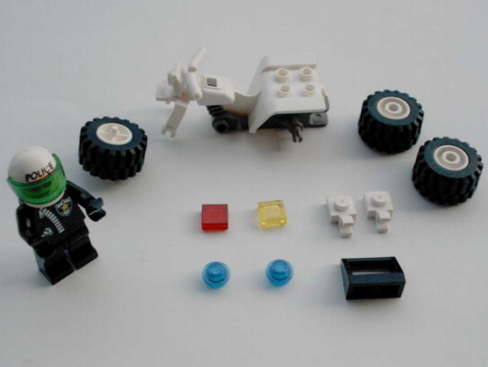
The design takes advantage of constraints to make its construction simple

Slide 38
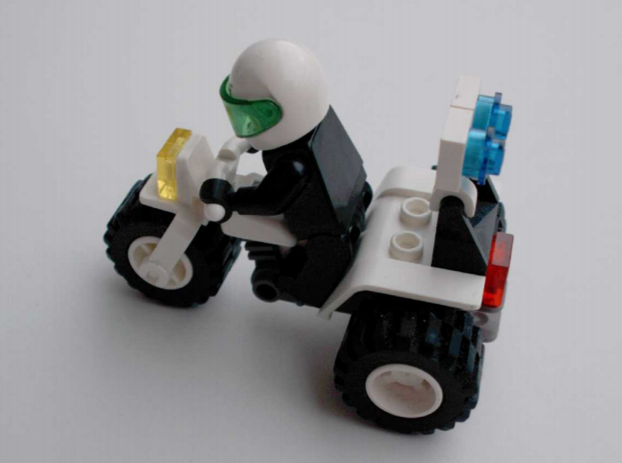

Slide 39
Conventions
Conventions are cultural constraints. They are initially arbitrary, but evolve and become accepted over time. They can however still vary enormously across diﬀerent cultures, for example:
Light switches: America down is oﬀ, Britain down is on
Water taps: America anti-clockwise is on, Britain anti-clockwise is oﬀ
The colour red: America danger, Egypt death India life, China happiness

Slide 40
Breakout: Affordances, Mappings, and Constraints
1. I will put you into breakout sessions in your student groups. 2. For 10 minutes:
• Take a look around your current environment.
• Which objects have which affordances?
• Find an object which has particularly good or particularly bad affordances, mappings, or constraints and take a photo of it.

Slide 41
The Principle of Causality
Causality is the relation between two events, cause and eﬀect, where the second occurs as a consequence of the ﬁrst.
Apparent causality is when something which happens immediately after an action, appears to have been caused by that action. We associate the eﬀect with the apparent cause.

Slide 42
False Causality
Coincidental eﬀects lead to superstition:
Touch a computer terminal just before it fails,and you are apt to believe you caused thefailure.
Start an unfamiliar application, just before the computer crashes.
Invisible eﬀects lead to confusion:
When an action has no apparent result, you may conclude it was ineﬀective (and repeat it). For example, repeatedly clicking the “Stop” button when the system is unresponsive.
→There is a need for feedback!

